Slide 1
NCL SA
Update

Slide 2
What we've been up to
2 successful passport to health events
Sparqs training
Campaign Days
Ready Set Apprentice
Welcoming Students
Scottish Student Sport

Slide 3
Passport to Health

Slide 4
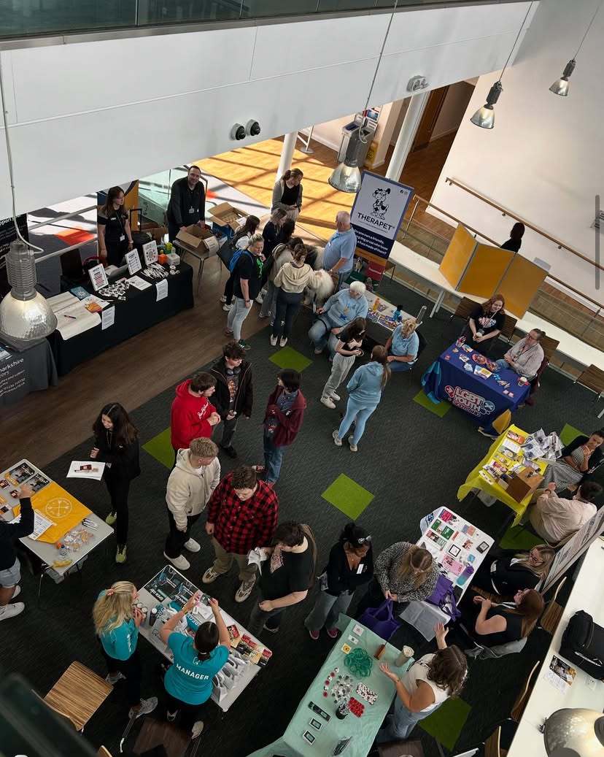
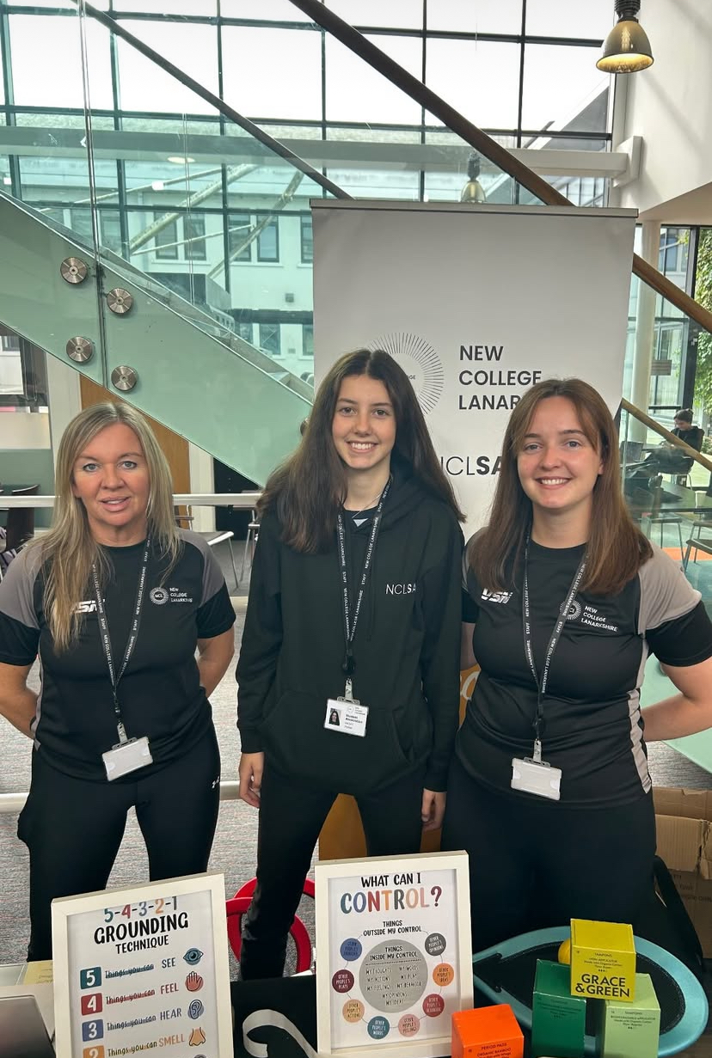
In May and the start of September the SA ran the Passport to health event.
It promoted health and wellbeing on campus with various partners coming in, mental health and wellbeing checks, therapets, music, physical health checks.
Many students said that they had benifited from the event!
We hope to run more events like this that are just as successful to help students find support and try out new things.

Slide 5
Passport to health video

Slide 6

Sparqs
That’s Quality and Class Rep Training

Slide 7
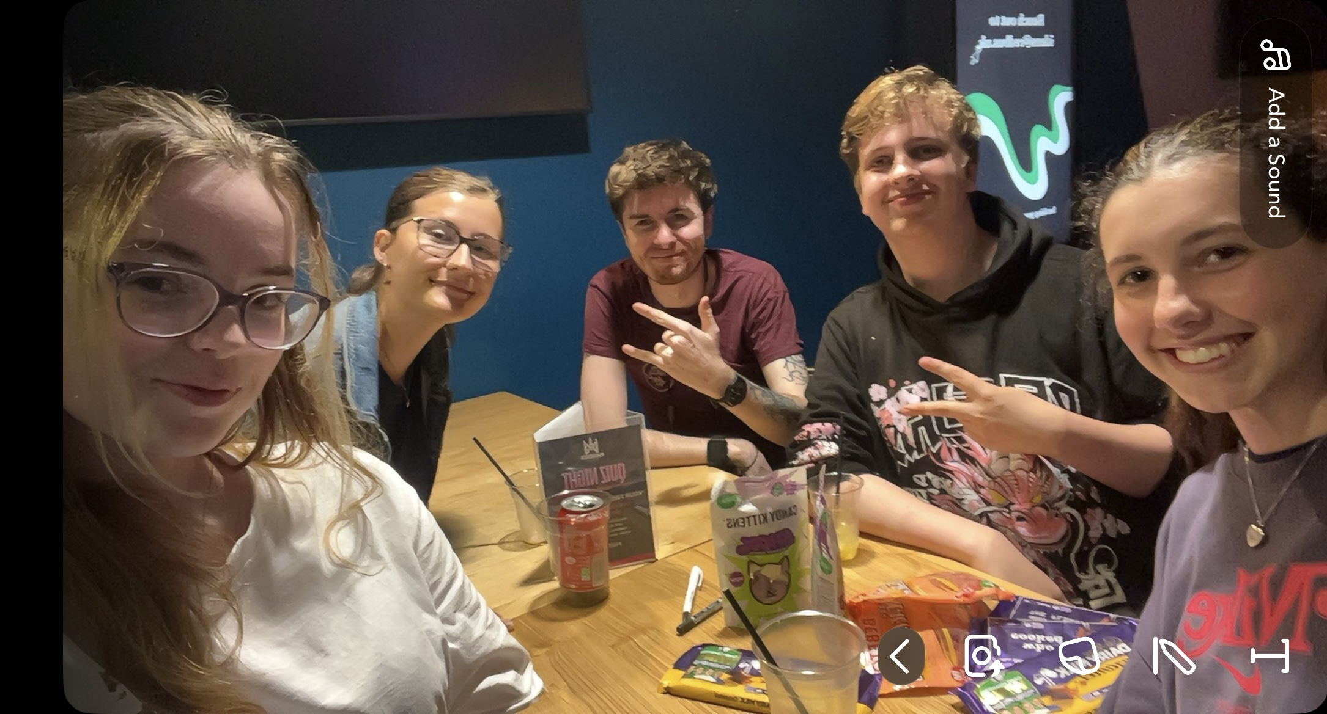
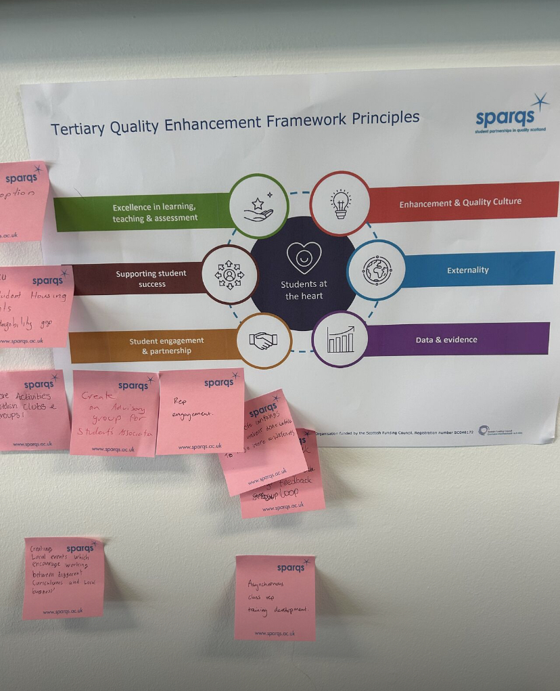
That’s Quality
That’s Quality is a two day event held at QMU Edinburgh for Scottish sabattical officers.
I got the chance to meet and chat to lots of amazing people, exchange ideas, join campaigns and made new friends!
I joined the Scottish student housing and poverty campaign
Gained valuable information on the process of writing a SEAP
UWS SU are coming to our Motherwell campus to see what wer'e doing to tackle poverty
My team also won the quiz!!!!!!

Slide 8
Class rep training
A great opportunity to meet people from other institutions and to see how they run
The training was really in depth and thourugh
NcL is now able to administer the training on campus in the Wellbeing academies
Class rep meeting attendance will hopefully go up because of this

Slide 9
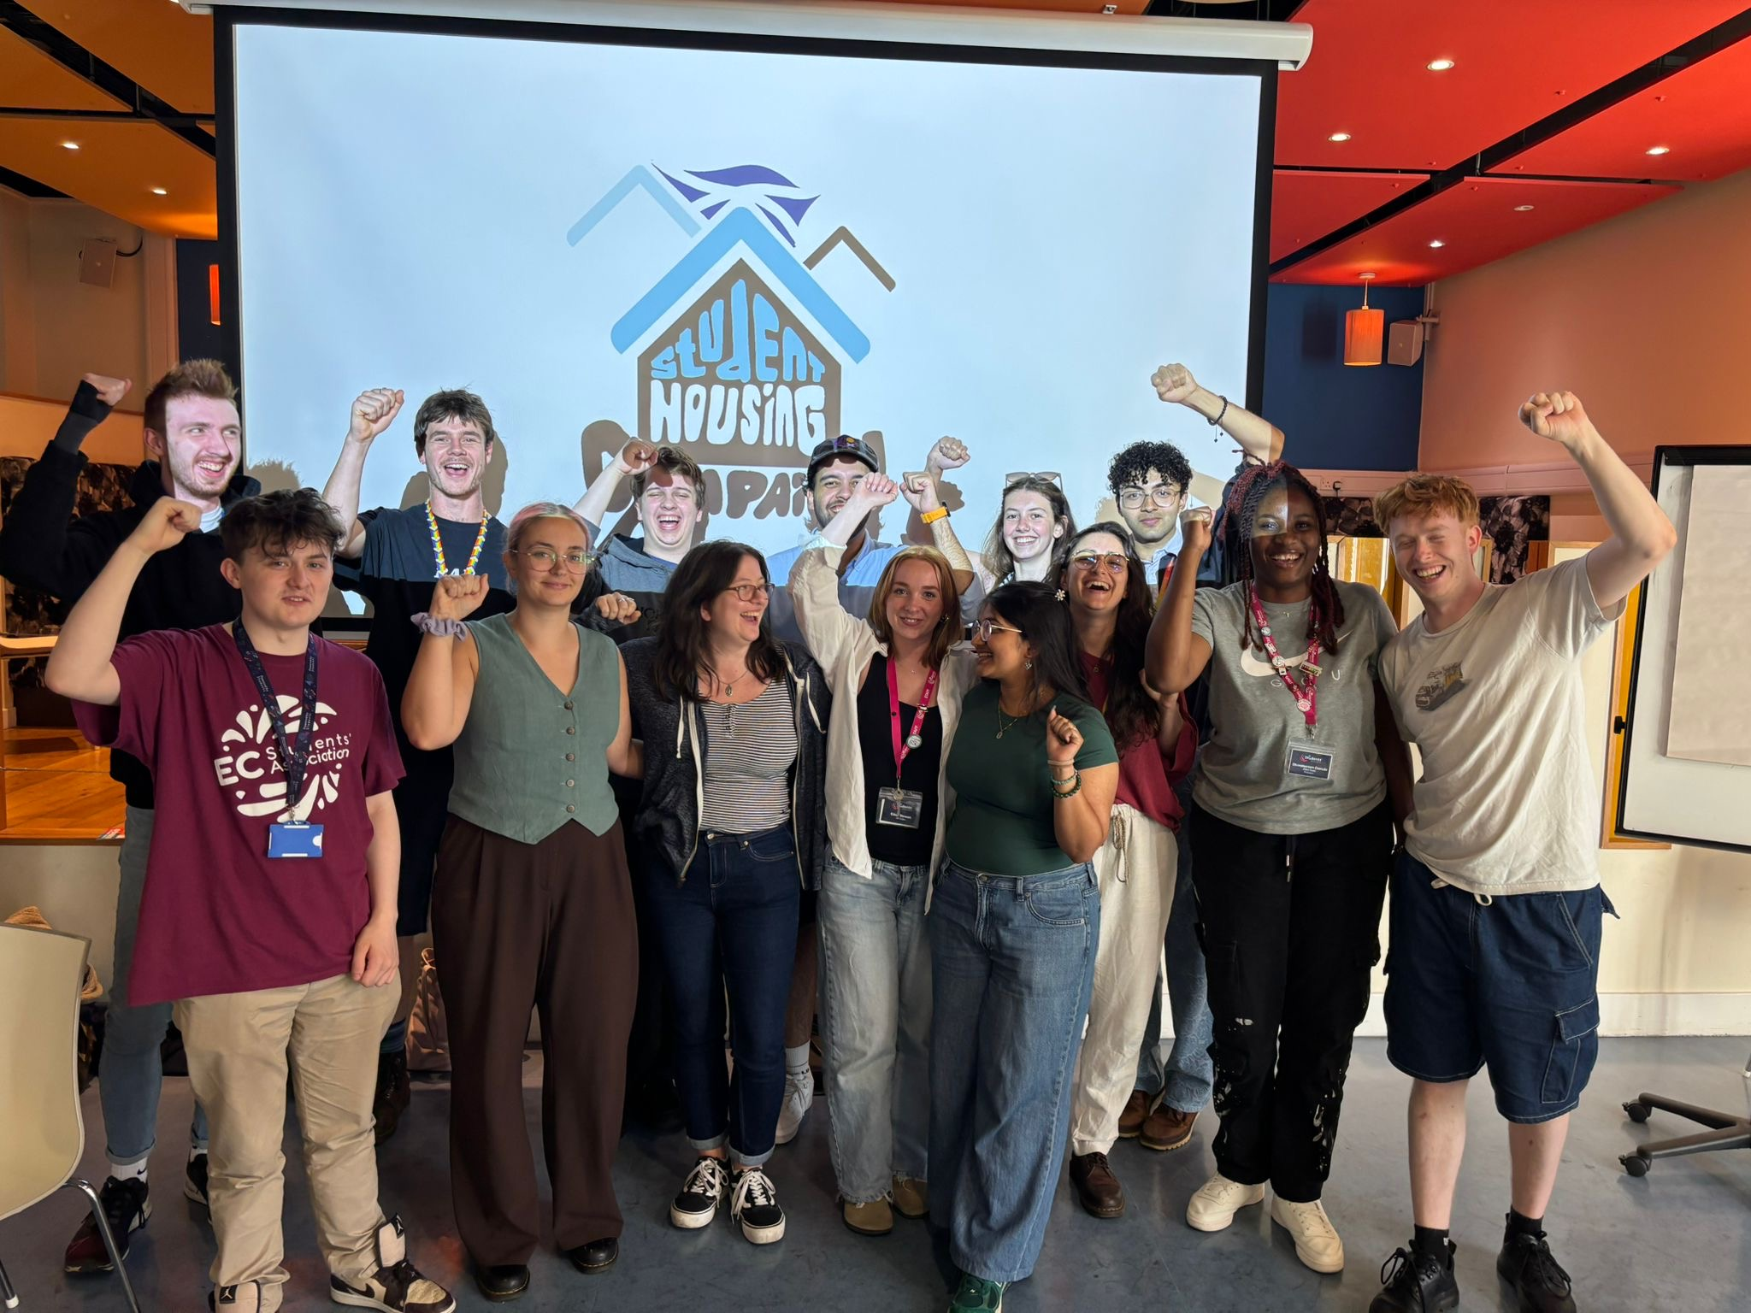
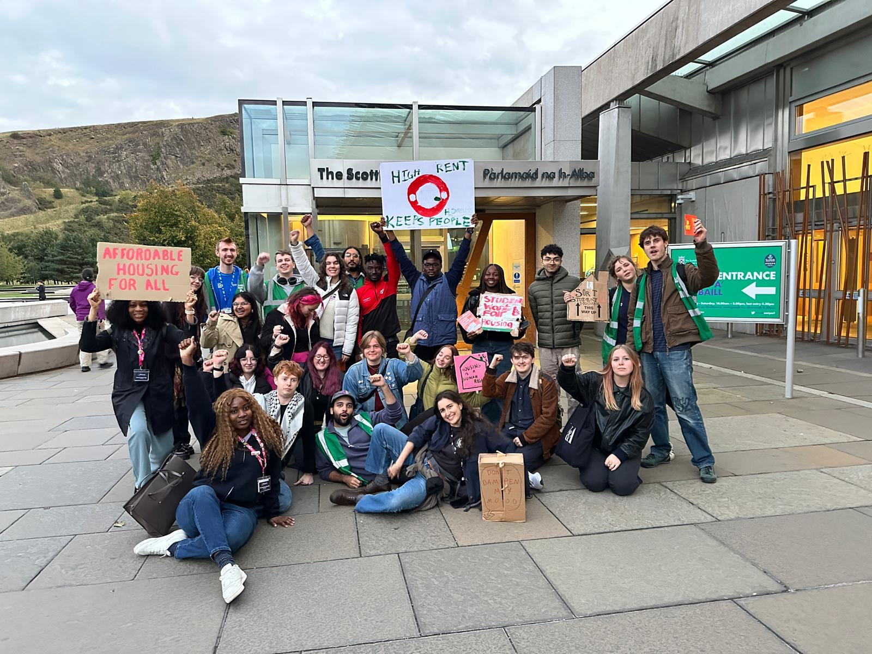
Campaigns I've been involved in
In August I joined the National Student Housing and Poverty Campaign.
The scottish government are pasing the Housing Bill currently, the action the campaign is taking ties in greatly with my manifesto priorites.
Further campaign mobilisation is happening on the 25th of October, I will be a key speaker at the Action For Poverty Rally.

Slide 10
Looking at GBV in Education and Election
I am hoping to be involved I the national campaign against GBV (gender Based Violence) in scottish institutions.
I met with Sandra McLaughlin to discuss a strategy for the upcoming election (scotland) to try and get our students to vote, holding a hustings was discussed.

Slide 11
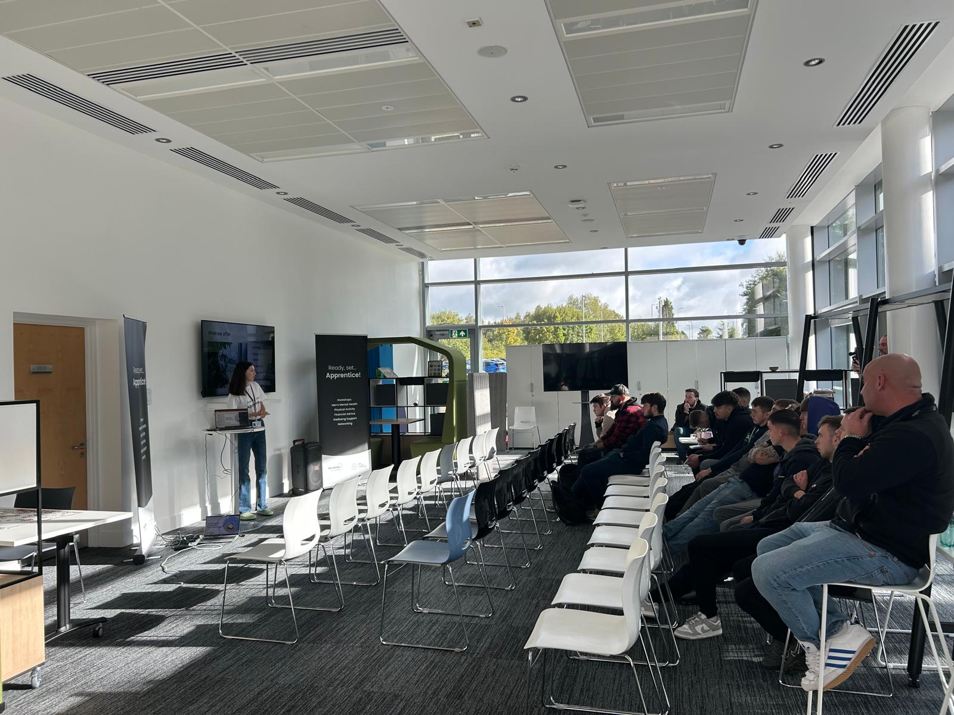

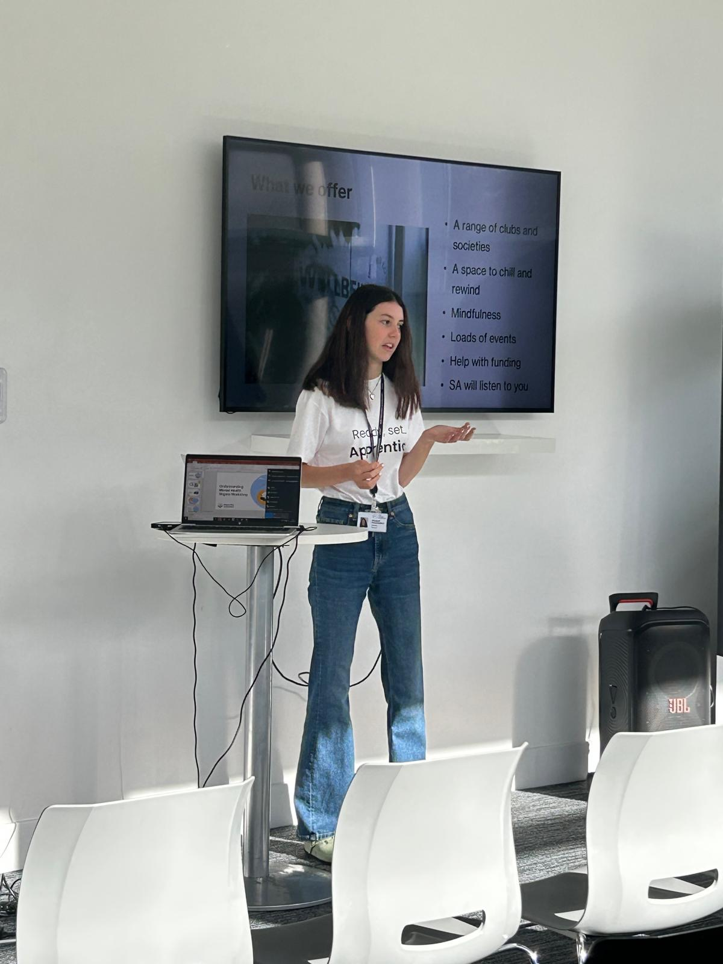
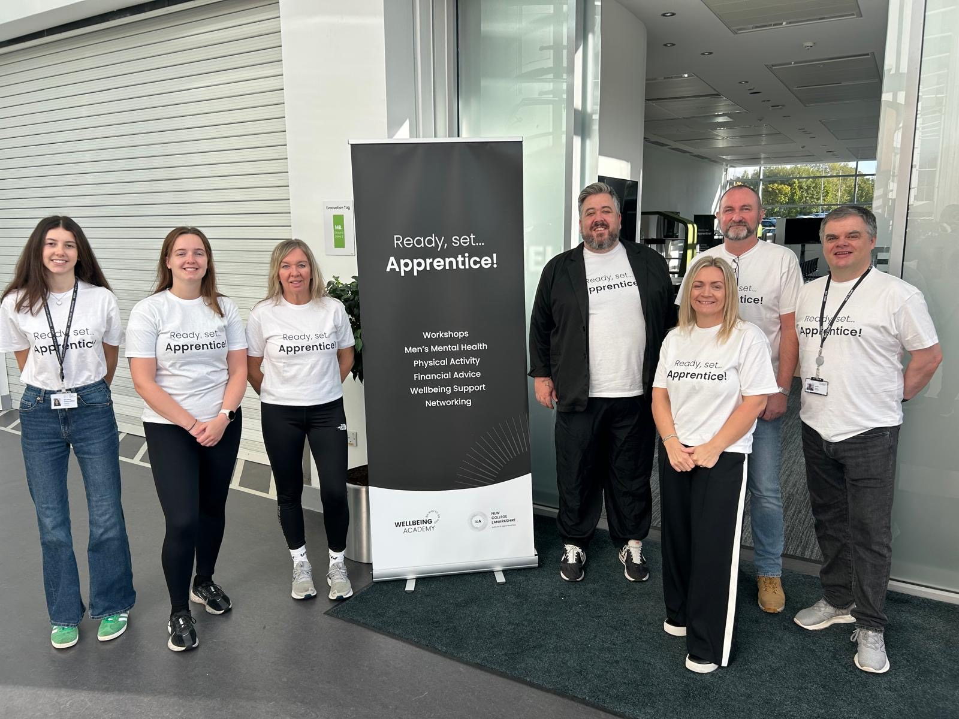
Ready Set Apprentice!
Over the last 2 week the SA held the Ready Set Apprentice event.
This event targeted our predomenlty male apprenticship students and offered them money help work shops, mens mental health sessions, team building, free lunches, sport and general wellbeing activites. We also launched our Padlet.
It was amazing to see so many students get involved!

Slide 12
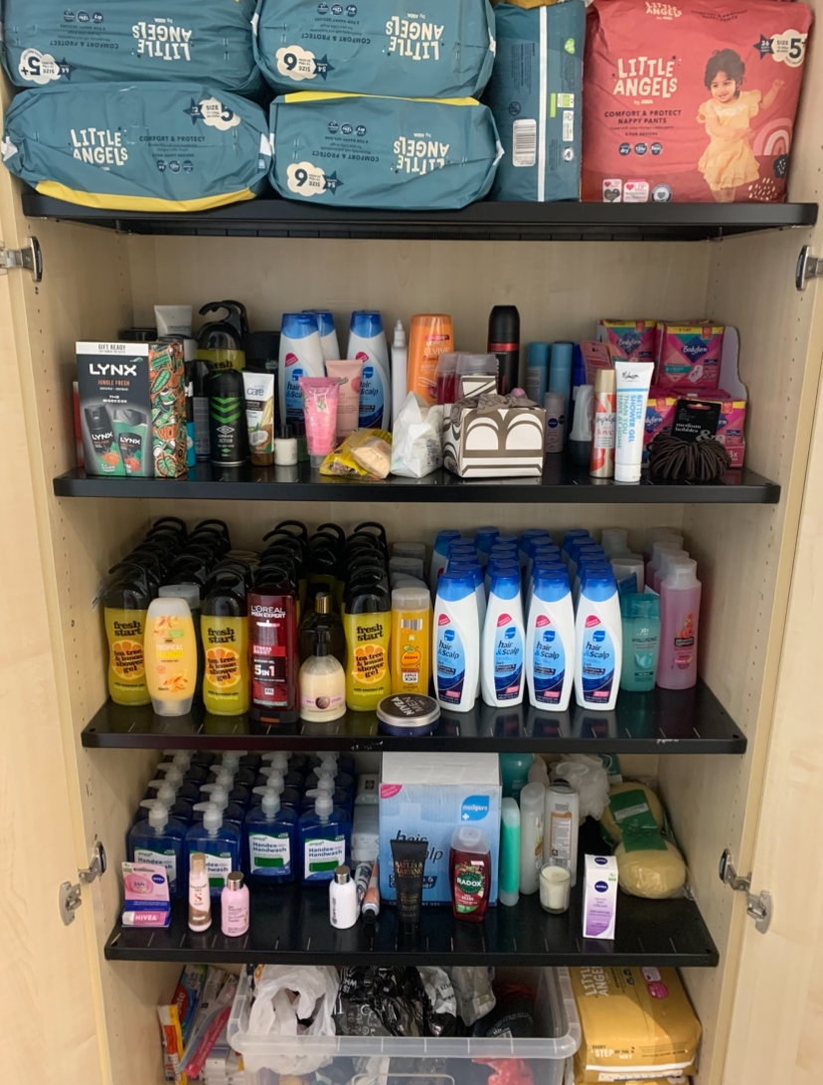
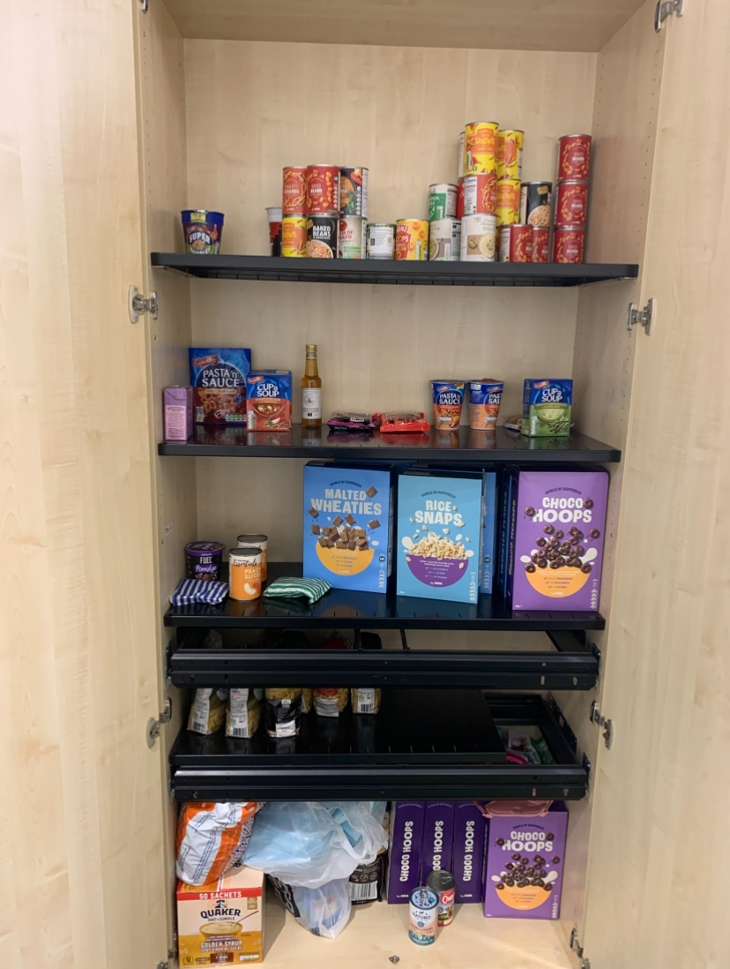
Welcoming Students
As Students have started coming back the SA has been supporting everyone that comes to us!
On the first week of term we had lots of our poverty bank uses.
Our wellbeing academies are back to being used as wellbeing spaces.
Lots of students have been enquiring about clubs and socieites

Slide 13
Scottish Student Sport
I was asked to be a college representative for SSS (Scottish Student Sport).
I have also been looking at getting more of our students involved in sport, particularly Football, Basketball and a new oppertunitiy that has arisen- Shinty!

